Slide 1

Students Counseling Cell

Slide 2
About
Life at campus is full of so much of happenings, like exams, social gatherings, class presentations, performance pressure, competition, field trips, relationships and much more.
Everyone has the right to make best out of his/ her student life and make it pleasantly memorable. This can be done by achieving and maintaining physical and mental health and creating a fine balance in life.
In order to help the students in their aspiring journeys, we have established counseling services. This service helps students to overcome their personal, academic and social problems and to flourish in life.

Slide 3
Team
Chair Person
Dr. P.Balamurugan,
Principal
Student Counseling Coordinator
Elavarasi D,
Assistant Professor/CSE
Department Counseling Coordinator
S.No. | Name of the Staff | Department
1. | Mr. Vijayaraj | AERO
2. | Mrs.Kalaiyarasi | CIVIL
3. | Mrs.Hemaswathi | CSE
4. | Mrs.Padmavathi | ECE
5. | Mrs.Nalini | EEE
6. | Mrs.Pandikumari | MECH

Slide 4
Roles of our Faculty
Our faculty meet with the student when they have plenty of time and will not be disturbed by others.
Students start feeling that, there is a staff member willing to spare time to listen to their problems.
Trust may not develop under every circumstance, but if it does, it will be because staff spared time to listen to them without interruption with keen attention, without prior judgment; listened to his thoughts without correcting them; listened to her just as she is and not as she "ought" to be.
This counseling system has an impact in improving attendance percentage of the students, academic performance as well. It also reflects on their other activities.
Number of students allocated per faculty: 15-18

Slide 5
Overall Academic Attendance Analysis below 80%

Slide 6
Overall Academic Attendance Analysis

Slide 7
Overall Academic Result Analysis

Slide 8
Department of EEE

Slide 9
Attendance Analysis
S.No. | SPR No. | Name of the Students | Percentage before Counseling | Percentage after Counseling
1. | 3341 | S.MadhanKumar | 68.61 (III Sem) | 93.5(IV Sem)
2. | 2731 | D.Raju | 75(V Sem) | 91(VI Sem)

Slide 10
Performance Analysis
S.No. | SPR No. | Name of the Students | Performance before Counseling | Performance after Counseling
1. | 4006 | K. Ajith Kumar | 16 Appeared (I Sem) | Cleared all in the next Sem
2. | 4085 | V.Tamilselvam | 10 Appeared in III Sem | 9 Cleared
3. | 4428 | T.Prithiviraj | Scored low marks in internal exams | He scored II Rank in university exam
4. | 3373 | M.Dhivagar | 20 Appeared in III sem | 17 Cleared
5. | 3468 | A.Robert Kennedy | 8 Appeared in V Sem | All Cleared

Slide 11
Performance Analysis
S.No. | SPR No. | Name of the Students | Performance before Counseling | Performance after Counseling
6. | 3366 | A.Rajesh Khanna | 8 Arrear in V Sem | All Cleared
7. | 3889 | R.Saravana Muthu | 9 Arrear In I Sem | All Cleared
8. | 2948 | Senpagapandi.A | 12 Appeared (V Sem) | 11 Cleared
9. | 3676 | N.Nishanthi | 9 Appeared (III Sem) | All Clear

Slide 12
Academic Performance Analysis

Slide 13
Participation of Co curricular & Extra Curricular
S.No. | SPR No. | Name of the Students | Percentage after Counseling
1. | 3560 | Balaganapathy.S | Presented National Conference and Symposium
2. | 4412 | Boominathan.P | Presented one Paper. Joined in Hockey Team
3. | 3481 | S.Vinith | Presented National Conference Vel tech and Symposium
4. | 3261 | S.Venkateswaran | Presented National Conference and Symposium
5. | 2817 | S.P.Karthikeyan | Presented National Conference and Workshop

Slide 14
Participation of Co curricular & Extra Curricular
S.No. | SPR No. | Name of the Students | Percentage after Counseling
6. | 2664 | Arasi | Presented National Symposium in ACTECH
7. | 2983 | Anushya | Presented National Symposium in ACTECH
8. | 2955 | S.Sathya | Mini project Presented
9. | 3167,3304 | Arunmozhi, Lakshminarayanan | Inplant Training

Slide 15
Participation of Co curricular & Extra Curricular
S.No. | SPR No. | Name of the Students | Percentage after Counseling
10. | 3155 | M.Mahibalan | Presented National Conference & Symposium
11. | 3174,3175,3327,2014 | Sathishkumar.C, Sathishkumar.C, Wesly Andrew.D,Dinesh Kumar.S | Participated in Short Film Competition and Won II prize

Slide 16
Discipline
S.No. | SPR No. | Name of the Students | Percentage before Counseling | Percentage after Counseling
1. | 3886 | M.Santhosh Kumar | He misbehaved in Class frequently | Now his attitude was changed towards Class room

Slide 17
Department of ECE

Slide 18
Attendance Analysis
S.No. | SPR No. | Name of the Students | Percentage before Counseling | Percentage after Counseling
1. | 2566 | Menaka J. | 87 (II Sem) | 93(V & VI Sem)
2. | 3398 | Selvakumar | 90 | 98
3. | 4504 | P.Palaniammal | 95 | 100

Slide 19
Academic Performance Analysis
S.No. | SPR No. | Name of the Students | Percentage before Counseling | Percentage after Counseling
1. | 3615 | K.Kalaiyarasn | 17 Appeared | 13 Cleared
2. | 3464 | Abdul Muthalib | 19 Appeared | 16 Cleared
3. | 2857 | M.Ramkuamar | 20 Appeared | 17 Cleared
4. | 2617 | Mohammed Imran.M | 13 Appeared | All Clear
5. | 2735 | S.Kaviyarasan | 10 Appeared | All Clear
6. | 3604 | C.Pounraj | 17 Appeared | 14 Cleared

Slide 20
Academic Performance Analysis
S.No. | SPR No. | Name of the Students | Percentage before Counseling | Percentage after Counseling
7. | 3997 | Jafar Ali.J | 11 Appeared | All Cleared
8. | 4600 | V.Vimala Devi | 12 Appeared | All Cleared
9. | 3021 | S. Karthik Kumar | 18 Appered | All Cleared

Slide 21
Academic Performance Analysis

Slide 22
Participation of Co curricular & Extra Curricular
S.No. | SPR No. | Name of the Students | Percentage after Counseling
1. | 2944 | Niveditha | Chess Competition – I Prize, Essay Competition – III Prize, Quiz – I Prize
2. | 3612 | J. Grace Soffana | Attend A Workshop in Android Apps in Kongunadu College
3. | 3615 | k.Kalaiyarasan | Attend A Workshop in Android Apps in Kongunadu College
4. | 3604 | C.Pounraj | Attend a Workshop on VLSI Design at Sudharsn Engg College
5. | 2620 | Celina Sunder Singh | Best Student Award

Slide 23
Participation of Co curricular & Extra Curricular
S.No. | SPR No. | Name of the Students | Percentage after Counseling
6. | 3431 | S.Navaneeth Krishnan | Participated in Chess, cricket. Won III prize in chess

Slide 24
DEPATMENT OF CSE

Slide 25
Attendance Analysis
S.No. | SPR No. | Name of the Students | Percentage before Counseling | Percentage after Counseling
1. | 2892 | Usha.T | 80 (III & IV Sem) | 93.5(V & VI Sem)
2. | 3729 | Shankar.R | 75 (IV Sem) | 88 (V sem)

Slide 26
Academic Performance Analysis

Slide 27
Academic Performance Analysis
S.No. | SPR No. | Name of the Students | Performance before Counseling | performance after Counseling
1. | 3008 | Madhumathi.M | 10 Apperaed | All Cleared
2. | 3808 | Ruba.G | 8 Appeared (II Sem) | All Cleared
3. | 2587 | Kanimozhi | 14 Arrear (V Sem) | 7 Cleared
4. | 2781 | Abinaya.S | 14 Appeared | 4 Cleared
5. | 3112 | Sarnya P. | 14 Appeared | All Cleared
6. | 2588 | Charlin Monisha | 13 Appeared | 6 Cleared
7. | 2643 | Durga Devi | 11 Appeared | All Cleared
8. | 3090 | Amala.S | 11 Apperaed | All Cleared

Slide 28
Academic Performance Analysis
S.No. | SPR No. | Name of the Students | Percentage before Counseling | Percentage after Counseling
9. | 2964 | Chella Priya | - | District Level university Rank
10. | 3075 | Sindhuja | 10 arrear | 5
11. | 3438 | Ramya.R | 6.7 CGPA V Sem | 8.2 CGPA
12. | 3437 | Vinothini.P | 10 Appeared | 5 Current All Cleared
13. | 4663 | Karthika.M | 11 Appeared | 7 Cleared
14. | 3729 | Shankar.R | 10 Appeared | 8 Cleared

Slide 29
Participation of Co curricular & Extra Curricular
S.No. | SPR No. | Name of the Students | Percentage after Counseling
1. | 3438 | Ramya.R | Extra Curricular
2. | 2964 | Chella Priya | Web site designing in Symposium

Slide 30
Discipline
S.No. | SPR No. | Name of the Students | Before Counselling | After Counselling
1. | 3150 | SHAMTIHA SHARON | REDUCED ACADEMICS PERFORMANCE DUE TO SOME PERSONAL PROBLEMS | SHE IS THIRD STAR IN III YEAR
2. | 3667 | KANMANI | REDUCED ACADEMIC PERFORMANCE DUE TO CHATTING IN WHATSAPP!. | DRASTICALLY IMPROVED. NOW HER ATTITUDE TOWARDS EDUCATION IS GOOD.
3. |  | YAZHINI | ADDICTED TO SOCIAL NETWORK | COUNSELING; DIVERTED HER CONCENTRATION FROM SOCIAL NETWORK AND CREATED INTEREST IN VIDEOS AND ANIMATION POSTED ON MOODLE
4. | 3739 | DEEPAN PRASANTH |  | HE HAD WRONG FRIENDS, NOW HE HAS CHANGED HIS ATTITUDE AND STARTED PROGRESSING BETTER.

Slide 31
Department of aero

Slide 32
Academic Performance Analysis

Slide 33
Performance Analysis
S.No. | SPR No. | Name of the Students | Percentage before Counseling | Percentage after Counseling
1. | 2905 | Sarath Kumar | Appeared 7 papers | All Cleared
2. | 2921 | Sanath Kumar | Appeared 7 papers | All Cleared
3. | 3920 | Priyanka | Appeared 7 papers | All Cleared
4. | 2999 | P.Durga | Appeared 10 papers | All Cleared
5. | 2674 | Vairavan | Appeared 11 papers | 10 Cleared

Slide 34
Participation of Co curricular & Extra Curricular
S.No. | SPR No. | Name of the Students | Percentage after Counseling
1. | 4540 | Tamil Selvan | Joined in the Football team
2. | 2999 | P.Durga | House Captain

Slide 35
Department of CIVIL

Slide 36
Attendance Analysis
S.No. | SPR No. | Name of the Students | Percentage before Counseling | Percentage after Counseling
1. | 3341 | S.MadhanKumar | 68.61 (III Sem) | 93.5(IV Sem)
2. | 2731 | D.Raju | 75(V Sem) | 91(VI Sem)

Slide 37
Academic Performance Analysis

Slide 38
Academic Performance Analysis
S.No. | SPR No. | Name of the Students | Performance before Counseling | Performance after Counseling
1. | 2829 | Veera Muthu.B | Appeared 9 | 8 Cleared
2. | 4007 | Surya.M | Appeared 9 | All Cleared

Slide 39
Participation of Co curricular & Extra Curricular
S.No. | SPR No. | Name of the Students | Percentage after Counseling
1. | 4285 | S.Chinna karuppan | He participating all extra curricular activity. He made amodel for symposium

Slide 40
Discipline
S.No. | SPR No. | Name of the Students | Performance before Counseling | Performance after Counseling
1. | 2896 | Tharkaz.Z.M | He came late daily | Now he coming Regularly
2. | 3282 | Alagu Pandi.R | His attitude towards the class is poor | Now he change his attitude.
3. | 3216 | Alagusundaram.P | He came late daily | Now he come to college at regular time.

Slide 41
Department of mech

Slide 42
Academic Performance Analysis

Slide 43
Academic Performance Analysis
S.No. | SPR No. | Name of the Students | Performance before Counseling | Performance after Counseling
1. | 3851 | Giritharganesh.J | 9 Appeared | All Cleared
2. | 3297 | Mohamed Abdullah | 11 Appeared | 7 Cleared
3. | 4084 | Harish Kumar.D | 7 Appeared | All Cleared
4. | 3500 | Saravanan.V | 18 Appeared | 15 Cleared
5. | 3814 | Clement Ruban.J | 11 Appeared | 10 Cleared

Slide 44
Academic Performance Analysis
S.No. | SPR No. | Name of the Students | Performance before Counseling | Performance after Counseling
6. | 2832 | Galil Ahamed.R | 8 Appeared | All Cleared
7. | 3297 | Viswanathan.T | 9 Appeared | 8 Cleared
8. | 2655 | Vijay.V.S | 13 Appeared | 10 Cleared
9. | 3396 | Gurunathan.S | 12 Appeared | 11 Cleared
10. | 2737 | Venkatesh.P | 11 Appeared | 10 Cleared

Slide 45
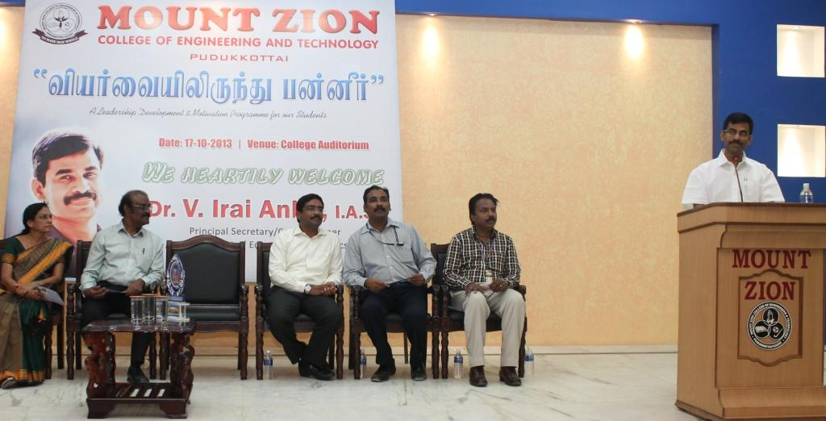
Motivational talk to the students by Dr.V. irai Anbu I.A.s

Slide 46
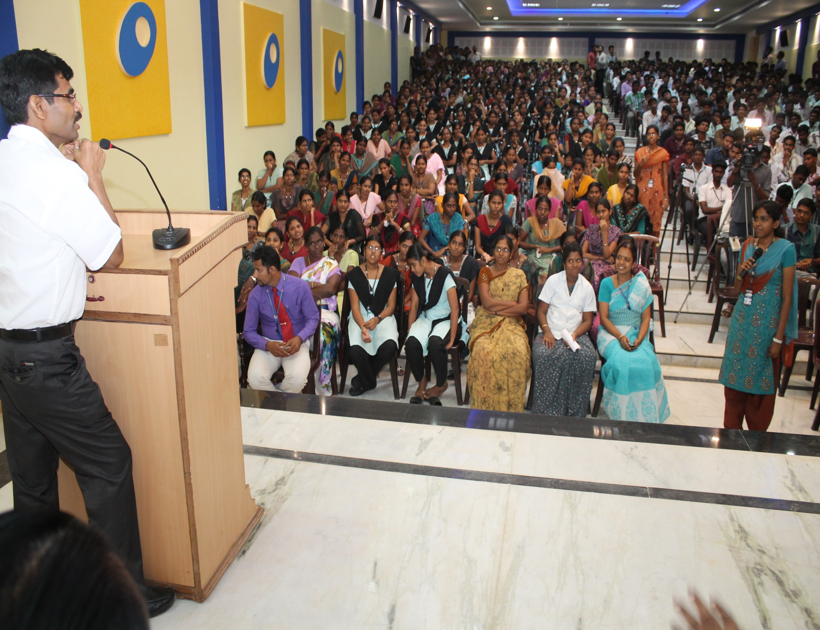
Students Interaction during the Session with Dr.V.Irai Anbu i.a.s

Slide 47
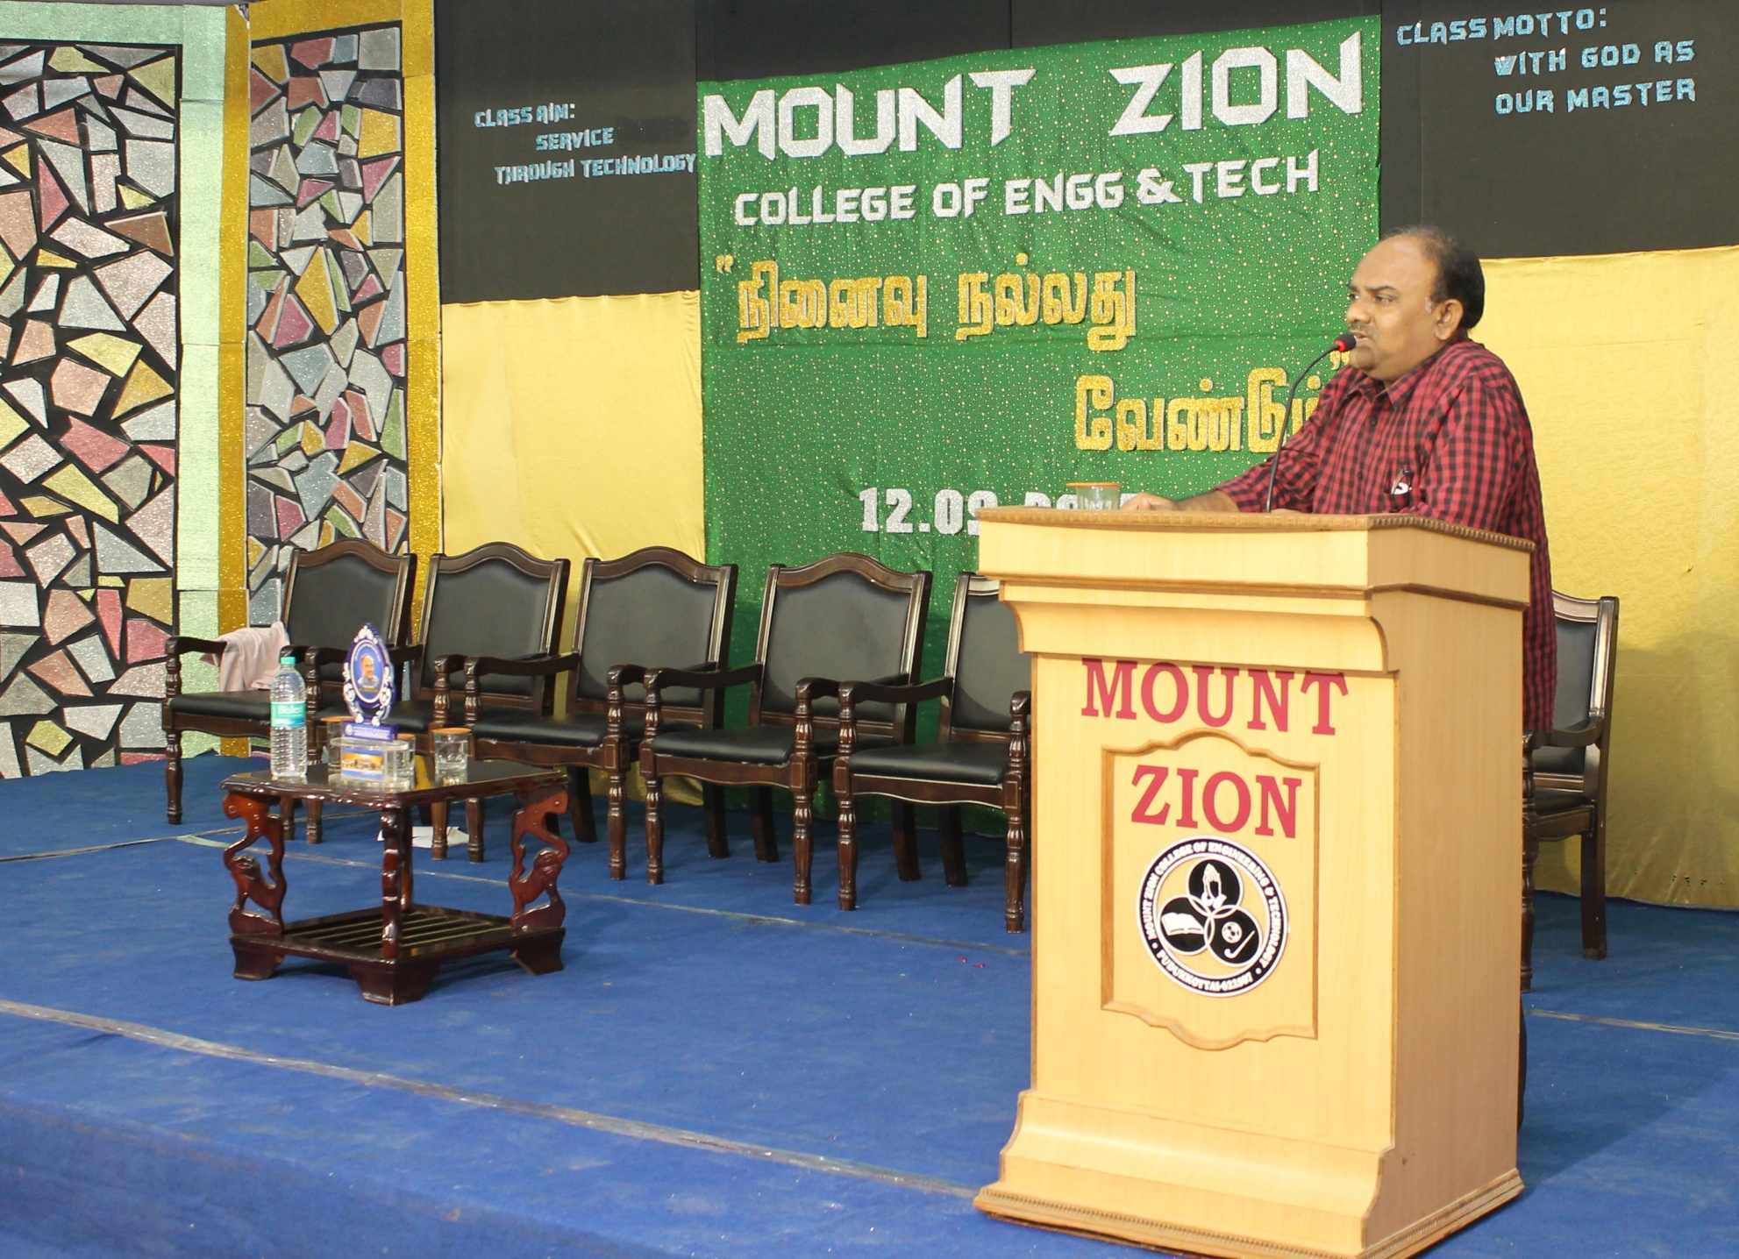
Motivational talk by Mr.S.Ramakrishnan, Tamil Writer for the students

Slide 48
Students Counseling ProgramME
Live Life by Dr. Kannan Gireesh, M.D

Slide 49
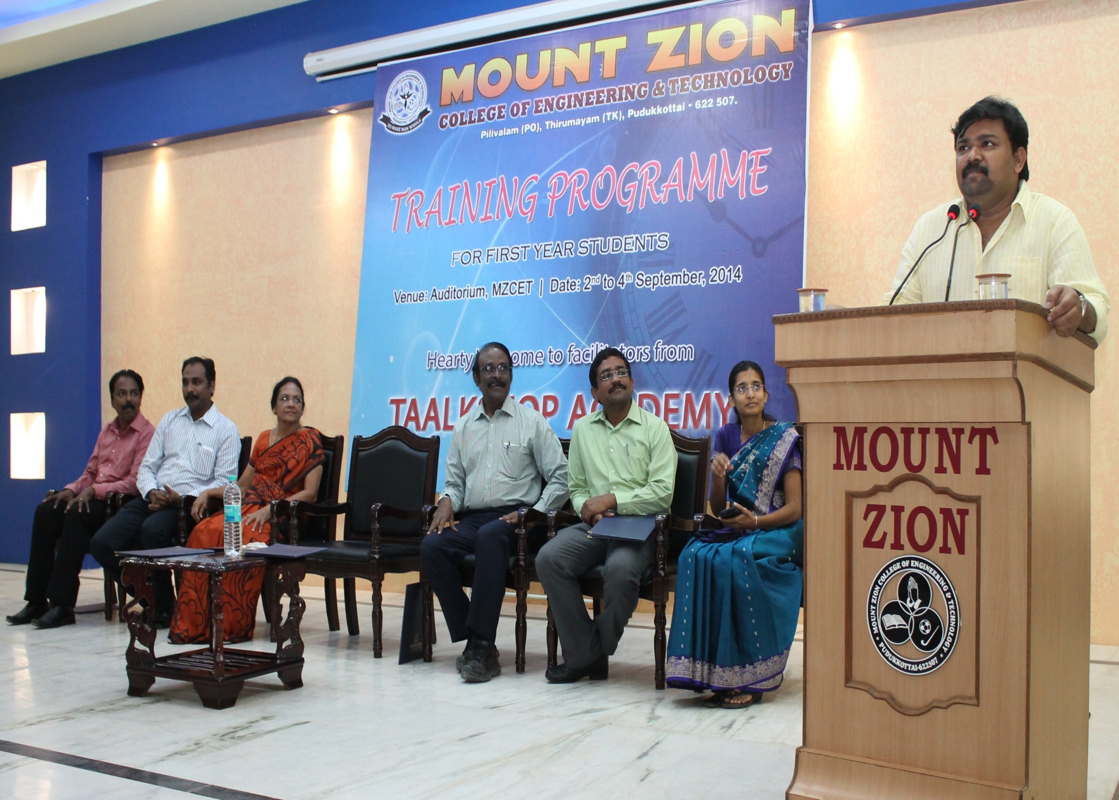
Training programme conducted by Mr.Gopinath, CEO Taalk shop academy for the first year students .

Slide 50
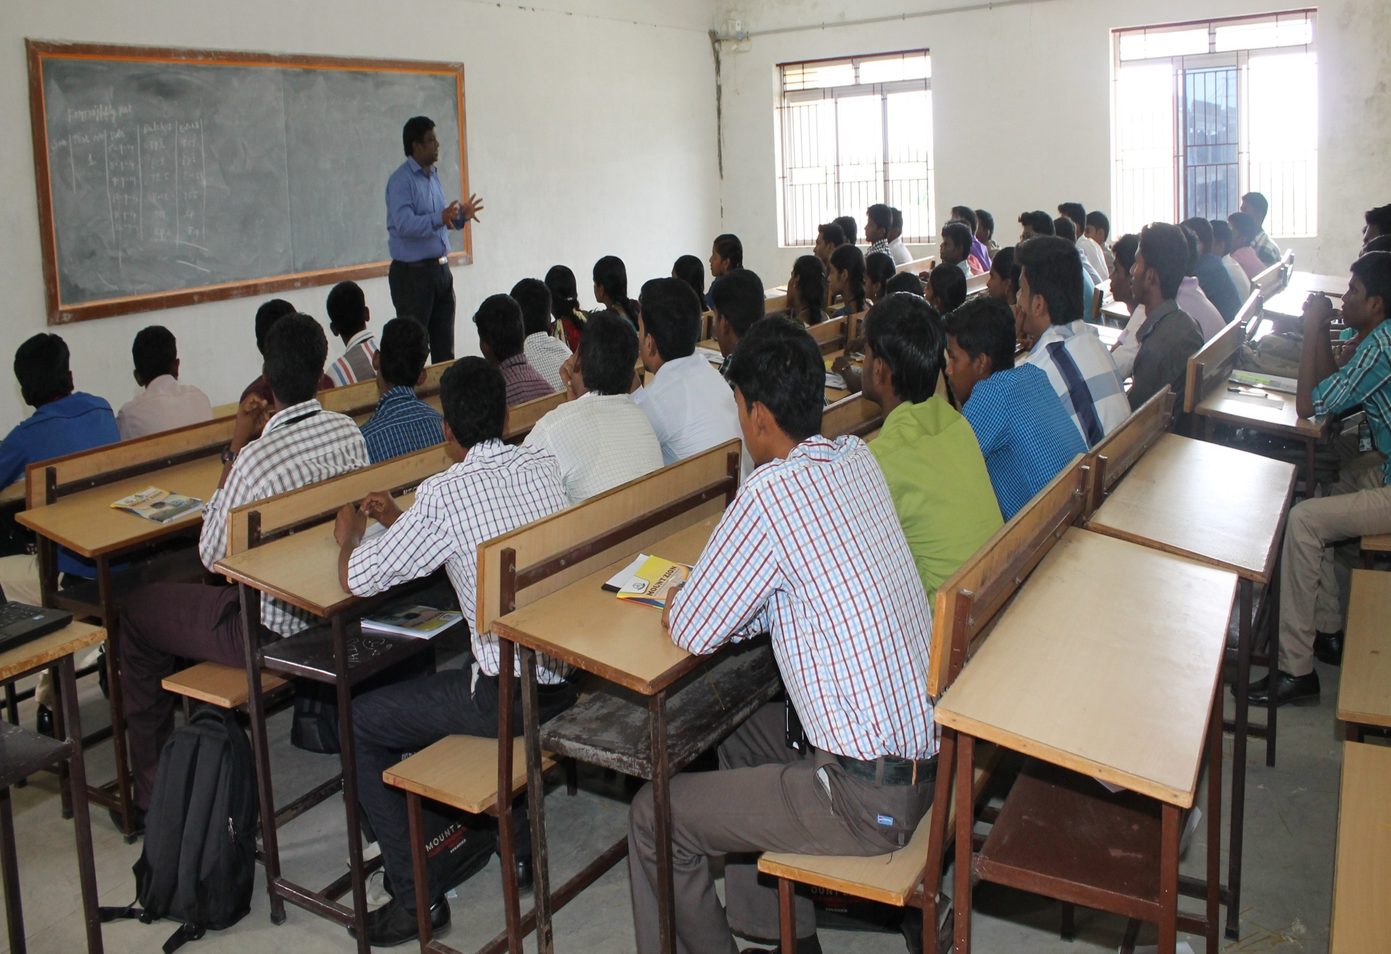
Training programme conducted by Mr.Gopinath, CEO Taalk shop academy for the first year students.

Slide 51
Methodology of students counseling
Program has arranged for staff regarding the counseling system, focused on the various factors.
Handling the students in the class.
Interacting with the students.
Indentifying their weakness and strength.
Motivating them to overcome their problems.

Slide 52
Methodology of students counseling Program conducted by Dr.Kannan Gireesh, Director, Live Life Pvt Ltd., for staff members.

Slide 53


